Slide 1
SQL Server 2019: The Modern Data Platform

Slide 2
Modernizing the WideWorldImporters Company
Mixture of SQL Server 2008, 2014, and 2016 servers
Expensive ETL applications for data sources outside of SQL Server
Should we use “Big Data” technologies?
Query performance tuning expensive
Some database applications suffer from I/O performance
Need data secure end-to-end with classification and auditing
Applications need better availability and less downtime
Our company uses a mixture of different operating system platforms
Popularity of containerized applications growing
What, when, and how should I migrate to the cloud?
Desire to build more intelligent applications with AI and Machine Learning
Notes:
2 mins

Slide 3




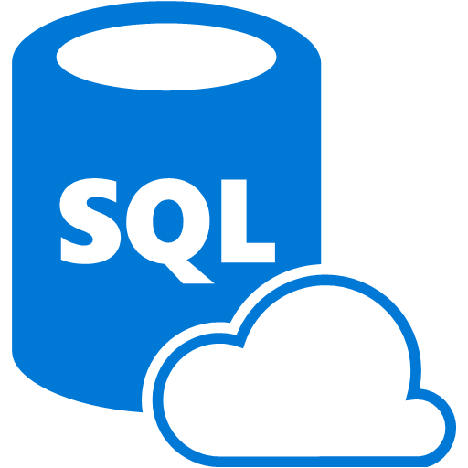
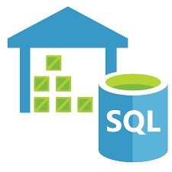
Azure Data Modernization Choices
WWI
SQL Server 2016
SQL Server 2017
SQL Server 2019
SQL
SQL Server in
Azure Virtual Machine (IAAS)
SQL
SQL Server 2008
SQL Server 2008R2
SQL Server 2012
SQL Server 2014
Azure SQL Database
Azure SQL Database Managed Instance
(PAAS)
Azure SQL Data
Warehouse
Notes:
2 mins

Slide 4
Built on SQL Server 2016 and 2017
Performance
Query Store
Adaptive Query Processing
Automatic Tuning
Columnstore and In-Memory OLTP
“It Just Runs Faster”
Security
Always Encrypted
Row Level Security
Dynamic Data Masking
Availability
Clusterless Availability Groups
Distributed Transactions for Availability Groups
Resumable Index Maintenance
Developer
JSON
Temporal Tables
Graph Database
Modern Platform
Linux and Containers
Machine Learning Services with R and Python
Notes:
2 mins

Slide 5












SQL Server 2019
Solving Modern Data Challenges
ciphertext
Polybase++
Query
SQL
101001010110
Secure Enclaves
Intelligent Query Processing
Learn
Memory grant
Enclave
In-Memory Databases
plaintext
Data Classification
Run query
Built-in Machine Learning and Extensibility
High Availability
R
Modern Platforms with Compatibility
Arm64
Accelerated Database Recovery
Notes:
5 mins
This is animated in this sequence
Data Virtualization with Polybase and Big Data Clusters
Intelligent Query Processing and In-Memory databases
Security enhancements with Always encrypted with enclaves
New HA capabilities such enhancements for AGs, built-in HA support from k8s and OpenShift, and Accelerated Database Recovery
Extensibility now with Java
Modern platforms choices with compatibility – Backup a db on any of these and restore to any of these

Slide 6
What you will learn in this workshop
Feature exists in Azure SQL Database
Connect to Azure SQL Database
Gain Performance with no application changes
Intelligent Query Processing
Need to classify and audit your data?
Data Classification and Auditing
Long running transactions affect your availability
Accelerated Database Recovery
Want external access with no data movement?
Data Virtualization
Is SQL Server on Linux and Containers compatible?
SQL Server Replication in one command
Additional capabilities and Migration
Additional capabilities, Migration Tools, and Database Compatibility
Azure Virtual Machines
Each of these are independent modules
Want slides to learn more?
https://aka.ms/bobwardms
https://github.com/microsoft/sqlworkshops/tree/master/SQLGroundToCloud/slides
Notes:
The areas in the blue are all features that exist 1:1 in Azure SQL Server Database.
For Kubernetes, this can also be deployed in Azure Kubernetes Service

Slide 7
Intelligent Performance with SQL Server The intelligent database Gain performance without changing the application
The Intelligent Query Processing feature family
Intelligent QP
Adaptive QP
Table Variable Deferred Compilation
Batch Mode for Row Store
Approximate QP
Scalar UDF
inlining
Intelligent Query Processing
Performance insights anytime and anywhere with Lightweight Query Profiling
Sequential Key Insert Performance
In-Memory Database
Hybrid Buffer Pool
Memory-Optimized TempDB Metadata
In-Memory OLTP
Persistent Memory Support
Adaptive Joins
Interleaved Execution
Memory Grant Feedback
Approximate Count Distinct
Batch Mode
Batch Mode
Row Mode
Bold indicates new and improved features in SQL Server 2019
Notes:
3 mins

Slide 8
Intelligent Query Processing
dbcompat to enable
140 | SQL Server 2017
150 | SQL Server 2019
The problem
Build a query processor to work and adapt to any type of workload with no application changes required
The Solution(s)
Build intelligent, adaptable operators
Modify query plans in cache based on previous execution
Expand batch mode
Execution data drives downstream compilation
Smarter query processing
Feature Suite
Adaptive Join
140
140
150
Memory Grant Feedback for Batch and Row
Batch Mode for Row Store
150
Interleaved Execution
Table Variable Deferred Compilation
140
150
Approximate Count Distinct
Scalar UDF Inling
150
Notes:
2 mins

Slide 9
Mission critical security Confidential computing
Always Encrypted with secure enclaves
plaintext
ciphertext
Always Encrypted with secure enclaves
Data Classification and auditing built-in
TDE scan suspend and resume
Simplified certificate management
Enhanced client driver
Enclave
plaintext
Notes:
2 mins

Slide 10
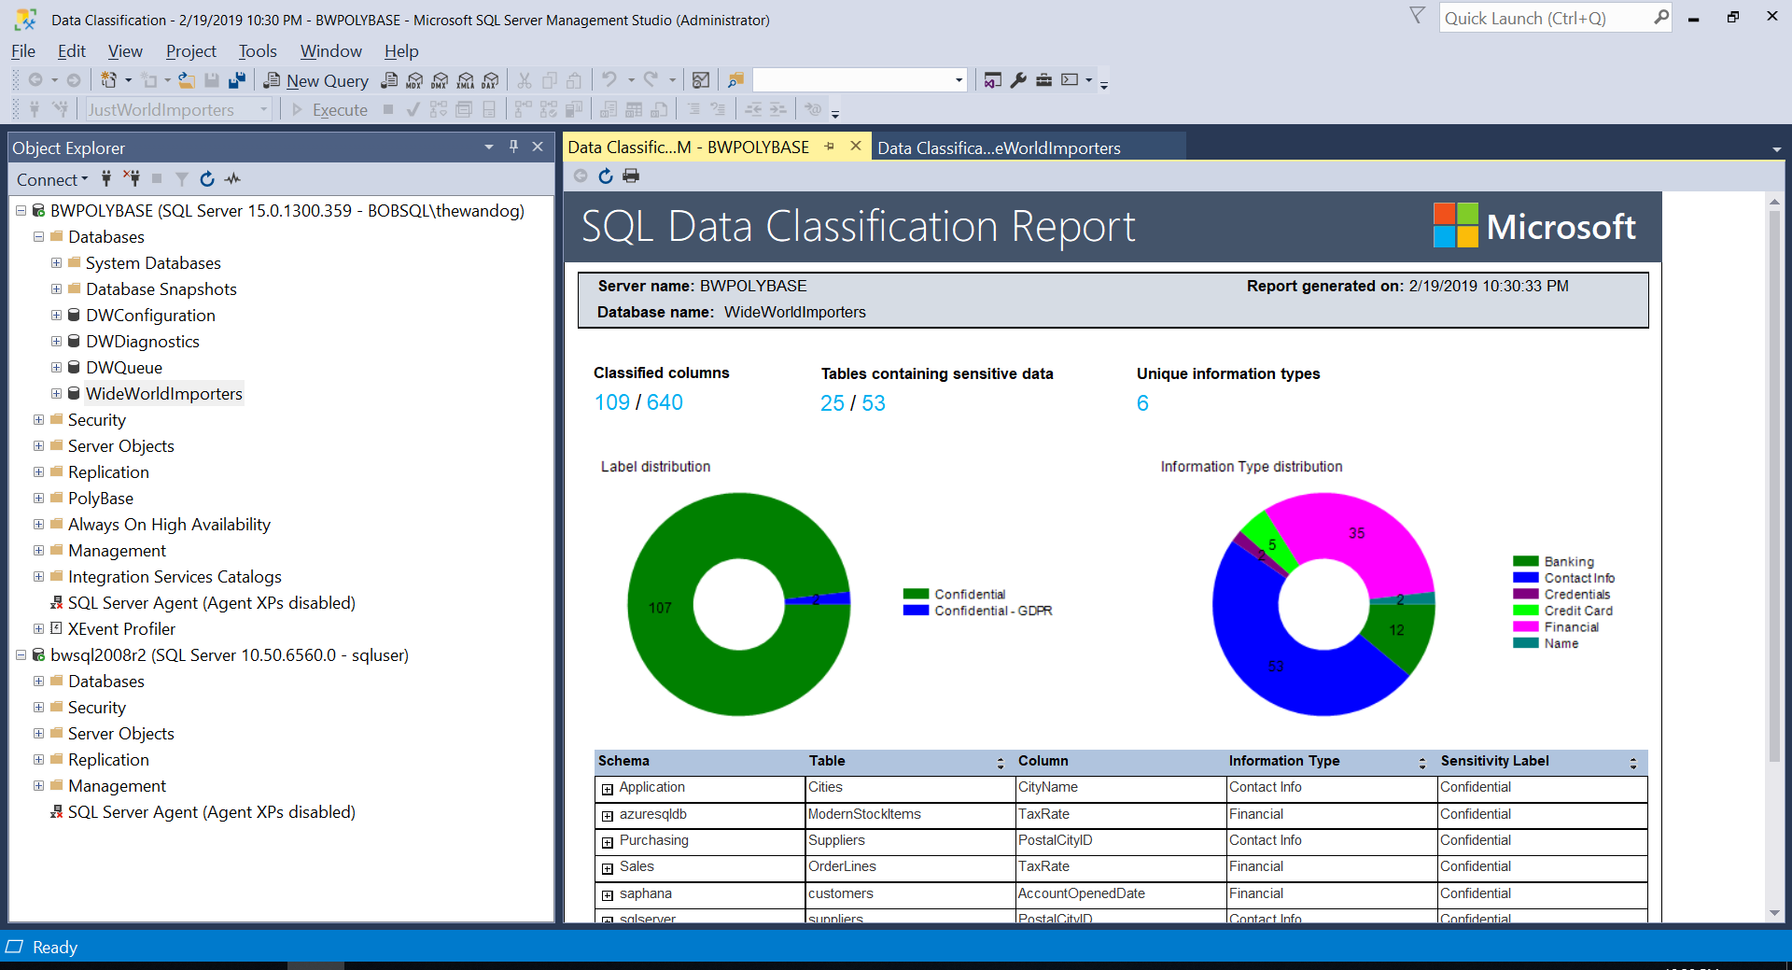
Data Classification and Auditing
The problem
I need to classify my data in SQL Server and audit access to the classified data
SQL Server 2017
SQL Server 2019 and Azure SQL Database
ADD SENSITIVITY CLASSIFICATION TO
dbo.sales.price, dbo.sales.discount
WITH ( LABEL='Highly Confidential', INFORMATION_TYPE='Financial' )
SQL Server Auditing
data_sensitivity_information
Who, what, and when accessed my classified data?
Notes:
3 mins

Slide 11
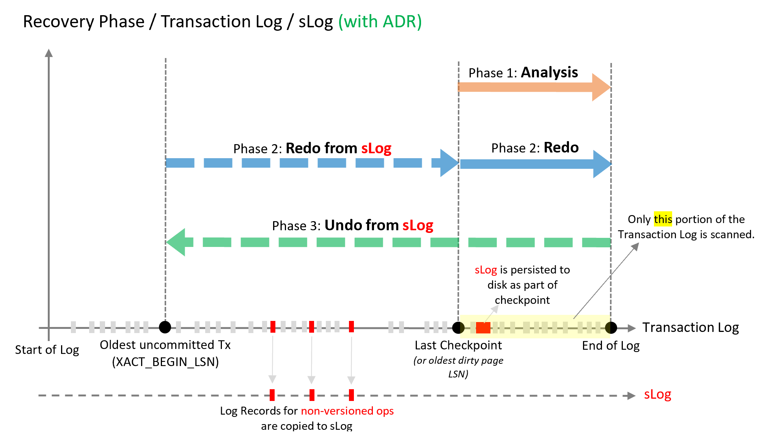
High Availability Keep SQL Server running
Online Index Enhancements
Availability groups Enhancements
Accelerated Database Recovery
Notes:
3 mins
Online index enhancements
Resumable online index creation
Online Clustered Columnstore index creation and rebuild
Always On availability group enhancements includes
Primary connection intent
More replicas

Slide 12
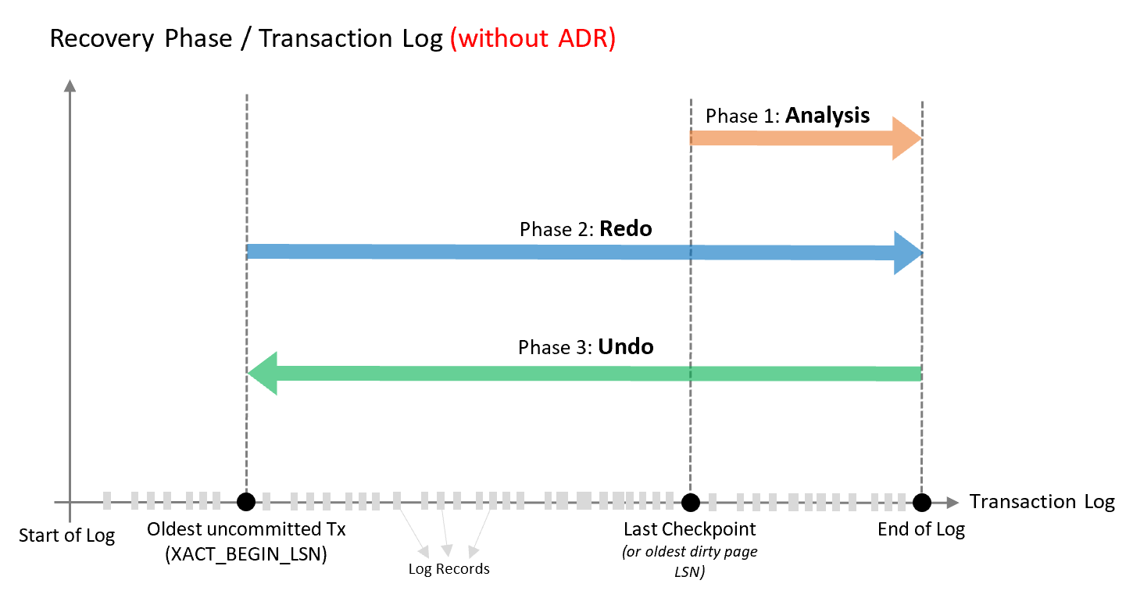
SQL Server Recovery and rollback
The problem(s)
Long running transactions affect recovery time
Rollback can take a long time for long transaction
Log grows out of control due to old active transactions
Parallel redo can help
“Long” recovery usually due to long undo
Undo dependent on oldest active transaction
Notes:
2 mins

Slide 13
Transactions accelerated
Persisted Version Store
Logical Revert
sLog
Cleaner
Improved Read Replicas
Notes:
3 mins

Slide 14
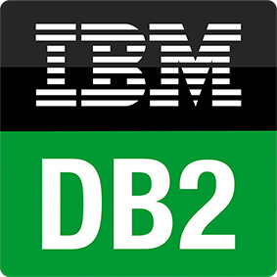
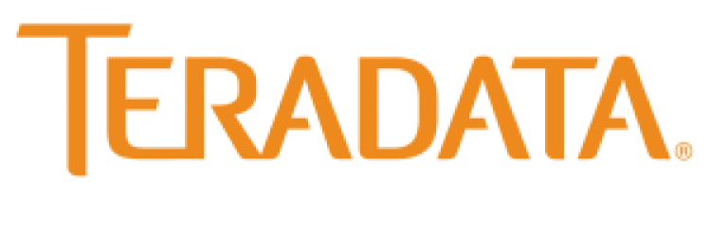




What is SQL Server Polybase?
“It’s all about
Data Virtualization”
It all started with T-SQL against Hadoop
Query data where it lives using T-SQL
Compute engine integrated with SQL Server
Distributed, scalable query performance
Manual/deploy with SQL Server
Auto deploy/optimize with Big Data Clusters
Analytics
T-SQL
Apps
SQL Server
PolyBase external tables
ODBC
NoSQL
Relational databases
Big data
Cosmos DB
HDFS
Intelligence over all data

Slide 15


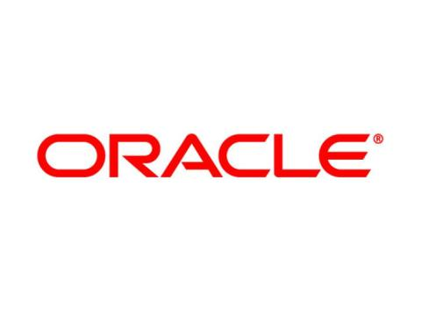


SQL Server 2019: Data Virtualization
Modern StockItems
Legacy Suppliers
Mobile
App Orders
WWI
SQL Server
2019
SQL
WideWorldimporters
Customers from Acquisition
Order Reviews
Accounts Receivable
Notes:
This is a great example for a company that has existing data sources but doesn’t want to or cannot move the data. This diagram can be demonstrated with a demo video or using the github examples at https://github.com/microsoft/sqlworkshops/tree/master/ModernizeYourDatabases2019/ModernizeSQL2019/Module%208%20Activity%20-%20Data%20Virtualization

Slide 16
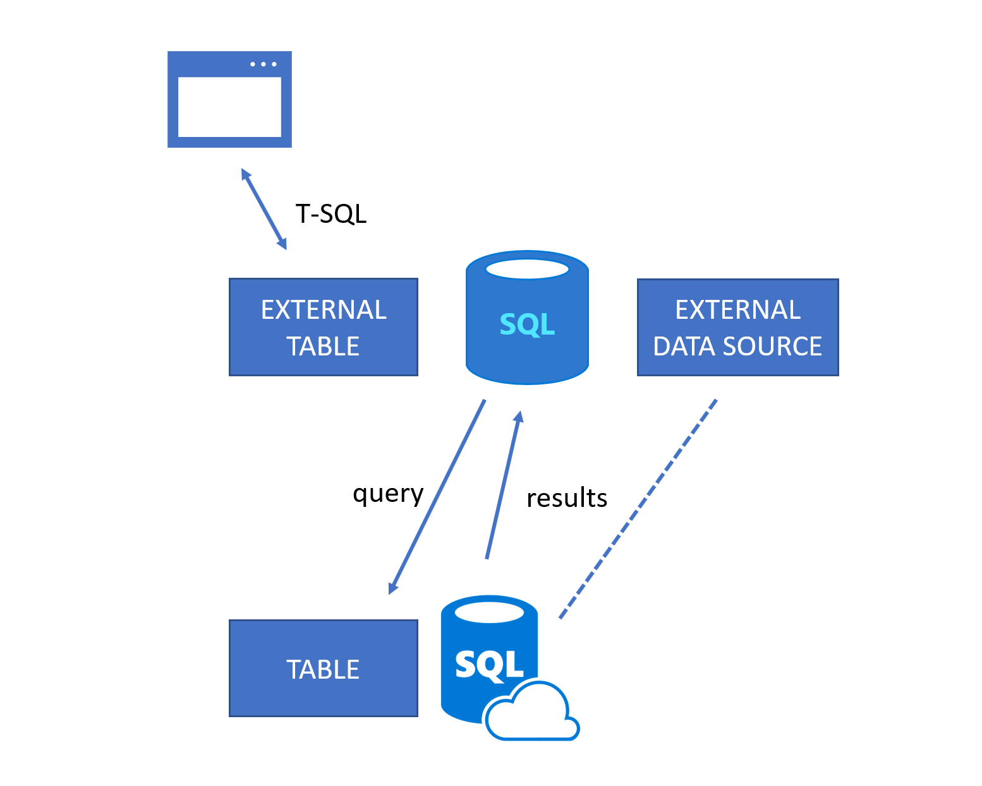
How does an external table work?

Slide 17
Big Data Clusters in SQL Server 2019
Data virtualization
Managed SQL Server, Spark, and data lake
Complete AI platform
Admin portal and management services
Integrated AD-based security
Analytics
T-SQL
Apps
REST API containers for models
SQL Server External Tables
SQL Server
Spark
SQL Server
ML Services
Spark & Spark ML
Compute pools and data pools
Scalable, shared storage (HDFS)
Open database connectivity
NoSQL
Relational databases
HDFS
External data sources
HDFS
Combine data from many sources without moving or replicating it
Scale out compute and caching to boost performance
Store high volume data in a data lake and access it easily using either SQL or Spark
Management services, admin portal, and integrated security make it all easy to manage
Easily feed integrated data from many sources to your model training
Ingest and prep data and then train, store, and operationalize your models all in one system
Notes:
BDC is all about providing the install and configuration of Polybase automatically but if you don’t have Hadoop we will install one for you and include Spark with it. The right side of the slide is about using BDC as a complete ML/AI platform. All of this deployed on a cluster that is secure and provides built-in management, HA, and scale using Kubernetes.
Note: As of CTP 2.5, BDC does not support ODBC drivers for Polybase

Slide 18
The same abstraction layer with SQL Server on Linux
System resource & latency sensitive code paths
All other systems
RDBMS
IS
AS
RS
SQL Platform Abstraction Layer
(SQLPAL)
SQL Platform Abstraction Layer
(SQLPAL)
Win32-like APIs
SQL OS API
Windows Host Ext.
Linux Host Extension
SQL OS v2
Windows
Linux
Host extension mapping to OS system calls
(IO, Memory, CPU scheduling)
Choice across OS and containers
Notes:
The Platform Abstraction Layer (“PAL”) is what enables SQL Server to run on Linux and Docker. The PAL is used to consolidate OS/platform specific code to enable SQL Server code to become OS agnostic.
The SQL Server team set strict requirements to ensure that functionality, performance, and scale were not compromised when deployed to Linux.
Part of what makes this possible is the integration of certain parts of MSR’s project Drawbridge. Drawbridge provided an abstraction between the underlying operating system and the application for the purposes of secure containers. Drawbridge was combined with SQL Server OS, which provided memory management, thread scheduling, and IO services, to create SQLPAL.
In short, the creation of the PAL allows the same, time-proven core code base for SQL Server to run on new environments such as Docker and Linux – as opposed to porting the Windows code base into multiple operating environments. SQL Server 2017 is not a re-write or a port – it is the same performant, scalable product Microsoft customers have relied upon for years.
Speaker note: for more detail, see https://blogs.technet.microsoft.com/dataplatforminsider/2016/12/16/sql-server-on-linux-how-introduction/

Slide 19





Platform of choice with compatibility
Windows
Linux
New capabilities for Linux
Replication
Change Data Capture
Distributed transactions
Machine Learning
Polybase
Tempdb files auto-config
Containers
Microsoft Container Registry
Red Hat Images
Non-root Containers
Containers and Kubernetes
Fintech company swiftly migrated workloads to SQL Server on Linux with minimal downtime and no performance issues
Modern platform

Slide 20

Why SQL Server and Containers?
Portable
Run anywhere containers are supported
Lightweight
Reduced disk, CPU, and memory footprint
Consistent
Consistent image of SQL Server, scripts, and tools
Efficient
Faster deployment, reduced patching, and less downtime
Container configuration
Persisted storage
Database
Switch for
simple upgrades
Container
Container
Container
sqlservr
sqlservr
sqlservr
Bins/libs
Bins/libs
Bins/libs
Container Runtime
Host OS
Infrastructure
Notes:
The right diagram is to show how to update SQL Server by “switching” containers

Slide 21
SQL Server - Shared storage HA in Kubernetes
Built-in HADR orchestration with no clustering required
Kubernetes
Node
Node
Node
Pod
Load Balancer Service
Pod
SQL Server
SQL Server
User
Pod
SQL Server
Persistent Volume Storage
Notes:
HA built into k8s for a single SQL instance

Slide 22
Enhancing the developer experience
Extend T-SQL with R, Python, and Java
Satellite
R
SQL Graph enhancements
UTF-8 support
Machine Learning Services enhancements
Extensibility Framework SQL Server Language Extensions
SQL Server
T-SQL
Direct communications for performance
Launch pad
Notes:
The diagram is to emphasize
Process isolation
Secure
Resource control with RG

Slide 23
Voice of the Customer
String or binary data would be truncated
Columnstore stats in DBCC CLONEDATABASE
Estimate compression for Columnstore indexes
Diagnostics for auto stats blocking
The #1 voted customer feedback item of all time: String Truncation (1000+ votes)
Troubleshoot page resource waits with new built-in T-SQL
Custom capture policy for the Query Store
MAXDOP and Memory Config during Setup
Reduce recompiles for tempdb workloads
Indirect Checkpoint Scalability
String or binary data would be truncated
in table '%.*ls', column '%.*ls’.
Truncated value: '%.*ls'
SELECT page_info.*
FROM sys.dm_exec_requests AS d
CROSS APPLY sys.fn_PageResCracker(d.page_resource) AS r
CROSS APPLY sys.dm_db_page_info(r.db_id, r.file_id, r.page_id,'DETAILED')
AS page_info;

Slide 24



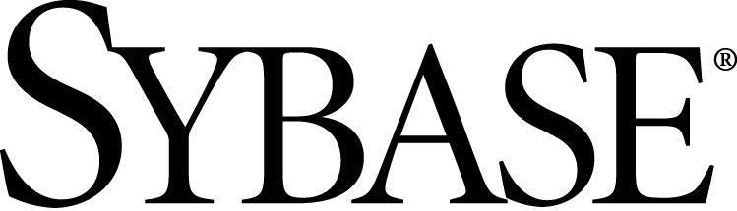
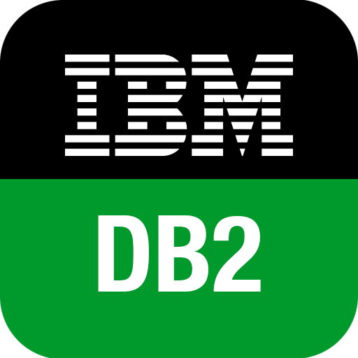

Migrate to the Modern SQL Server
Migration from legacy SQL Server
Migration from external databases
Azure Site Recovery
Database Experimentation
Assistant
SQL
SQL
Legacy SQL Server
SQL Server 2017
SQL Server 2019*
SQL Server in Azure Virtual Machine
SQL Server
Microsoft Access
In-Place (Windows)
Database Backup
Log Shipping
Bulk Import
SSIS
Data Migration
Assistant
Azure Database Migration Service
SQL Server Migration Assistant (SSMA)
Query Tuning Assistant
* Coming by GA

Slide 25
Certify once, run on-premises and in the cloud with Compatibility Certification
Upgrade & modernize your SQL Server database on-premises, in the cloud and on the edge with Compatibility Certification that eliminates risks of application compatibility
Upgrade to the latest SQL Server Database Engine without changing your critical applications
Compatibility Certification benefits
Unified application certification
Applications tested and certified on a given SQL Server version are also implicitly tested and certified on that SQL Server version native database compatibility level
Reduce upgrade risks
Separate application and platform layer upgrade cycles for less disruption
Microsoft fully supports Compatibility Certification
Frictionless migration with no code changes
Upgrade to latest SQL Database Engine version
Upgrade your SQL Server Database Engine or move instances to the cloud with no code changes
Notes:
Starting with SQL Server 2016, the SQL Server team has stopped deprecating compatibility levels purposefully. The Database Engine is also literally the same accross SQL Server and Azure SQL (including Managed Instance), so a database can be moved seamlessly and the same database code (T-SQL) works the same and undergoes the same optimization processes.​
Therefore, an application that was certified for compatibility 100 (SQL 2008) can work with the same behavior that was set for that version, even when moved to Azure SQL or a modern version of SQL Server.​
This means:​
•No more need to specifically certify for Azure or on-premises separately. Applications tested and certified on a given SQL Server version are also implicitly tested and certified on that SQL Server version native database compatibility level.​
•Reduced upgrade risks because during platform modernization, application and platform layer upgrade cycles can be separated for less disruption, and improved change management​
•Upgrading to a new version of SQL Server or Azure SQL can be done with no code changes by keeping the same compatibility level as the source​
New Databases are set to compatibility level mapping to the version of the Database Engine. When a database is upgraded from any earlier version of SQL Server, the database retains its existing compatibility level if it is at least minimum allowed for that instance of SQL Server or Azure SQL. Upgrading a database with a compatibility level lower than the allowed level (for example from SQL 2005), sets the database to the lowest compatibility level allowed.

Slide 26
Next Steps for SQL Server 2019
http://aka.ms/bobwardms
http://aka.ms/bobsqldemos
http://aka.ms/sqllinuxbook
Use our free training at https://aka.ms/sqlworkshops
Learn from videos and demos at https://aka.ms/sqlchannel
Download and try SQL Server 2019 at http://aka.ms/ss19
Read the what’s new for SQL 2019 documentation
Sign-up for the EAP program at https://aka.ms/eapsignup
Watch the video Modernizing SQL Server at https://www.youtube.com/watch?v=5RPkuQHcxxsto to plan your migration

